Slide 1
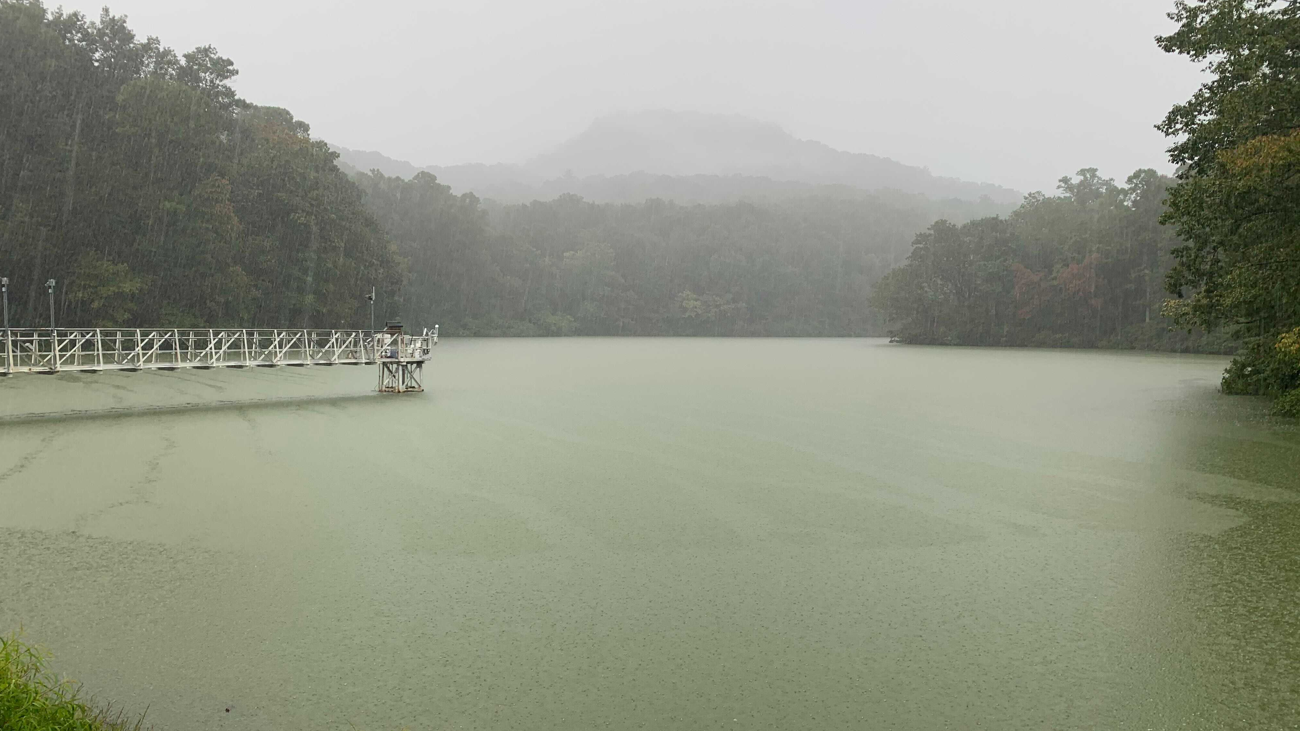
Effects of hypoxia on carbon burial differ by timescale in two freshwater reservoirs Abby Lewis, Madeline Schreiber, B. R. Niederlehner, Arpita Das, Nick Hammond, Mary Lofton, Heather Wander, Cayelan Carey
photo by Heather Wander
Notes:
Highlight Arpita, Mary, and Heather

Slide 2




Lakes and reservoirs are hotspots for global carbon processing
2 Pg CO₂e
0.12 Pg C
10 Pg CO₂e
0.2–0.6 Pg C
Second State of the Carbon Cycle Report (SOCCR2)
Notes:
10*15
petagrams of carbon
Earth’s climate is regulated by complex interplay between uptake and release of greenhouse gasses from the atmosphere.
Freshwater lakes and reservoirs play a disproportionate role in these cycles.

Slide 3

Lakes and reservoirs are hotspots for global carbon processing
2 Pg CO₂e
0.2–0.6 Pg C

Slide 4

Lakes and reservoirs are hotspots for global carbon processing
2 Pg CO₂e
0.2–0.6 Pg C
LOW
OXYGEN
Notes:
petagrams of carbon
Earth’s climate is regulated by complex interplay between uptake and release of greenhouse gasses from the atmosphere.
Freshwater lakes and reservoirs play a disproportionate role in these cycles, sequestering more carbon than ocean sediments each year.

Slide 5
Lakes and reservoirs are hotspots for global carbon processing
2 Pg CO₂e
0.2–0.6 Pg C
LOW
OXYGEN
Notes:
petagrams of carbon
Earth’s climate is regulated by complex interplay between uptake and release of greenhouse gasses from the atmosphere.
Freshwater lakes and reservoirs play a disproportionate role in these cycles, sequestering more carbon than ocean sediments each year.

Slide 6

Mineral protection
Respiration
High-oxygen
Low-oxygen
microbes
Fe(II)
microbes
Fe(III)
Notes:
Less energy from anoxia
Fewer microbes?
Timescale!!!

Slide 7
Mineral protection
Respiration
How do low-oxygen conditions affect carbon burial in reservoirs?
Notes:
In particular, associations between iron (Fe) and organic carbon (OC) are hypothesized to play an important role in facilitating aquatic carbon sequestration, but Fe-bound OC (Fe-OC) complexes may be sensitive to changes in oxygen concentrations in overlying water.

Slide 8
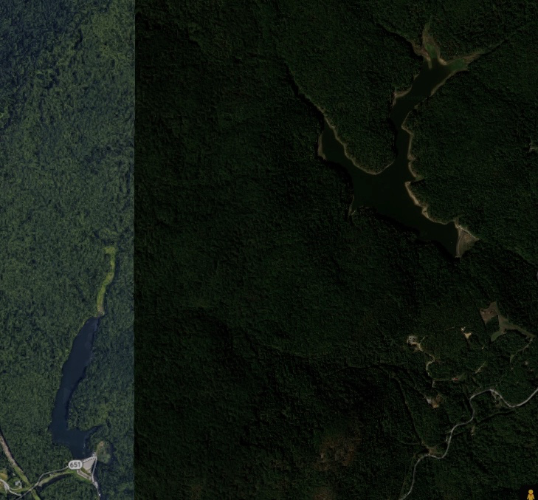
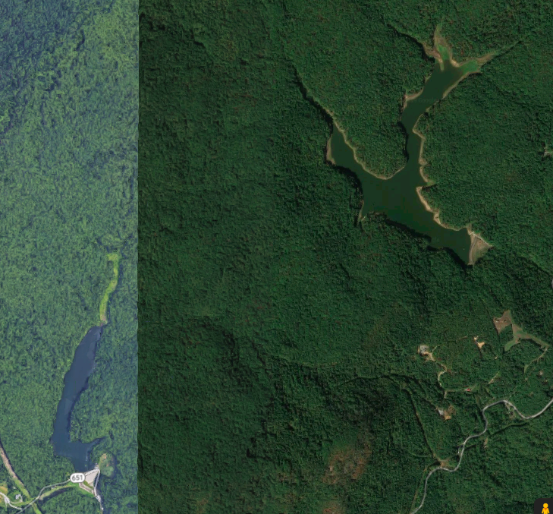
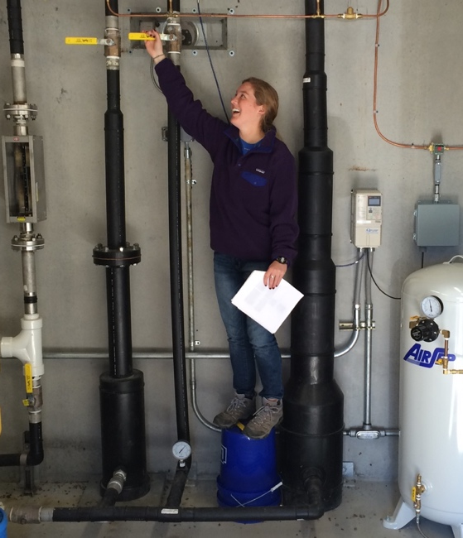
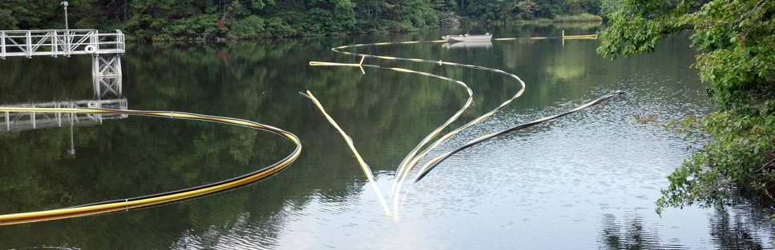

Whole-ecosystem oxygenation experiments
Beaverdam Reservoir
Falling Creek Reservoir
1 km

Slide 9
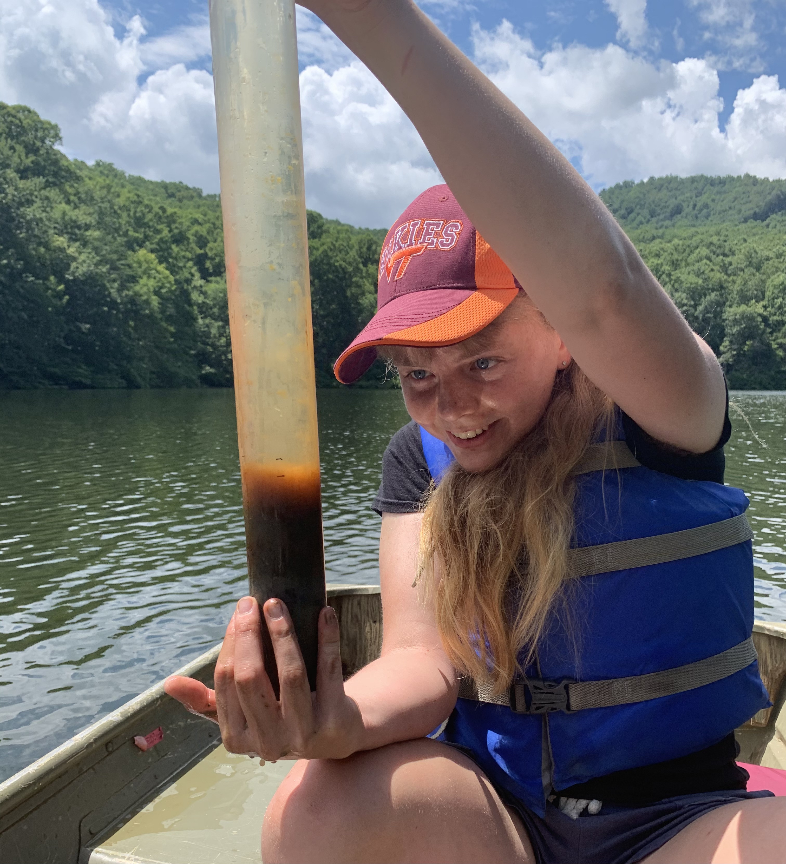
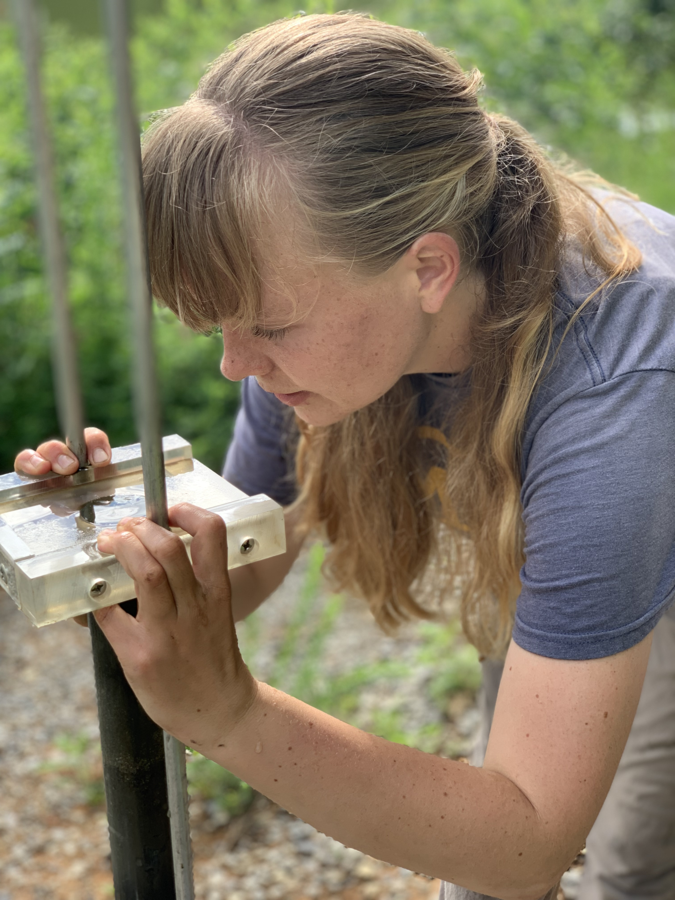
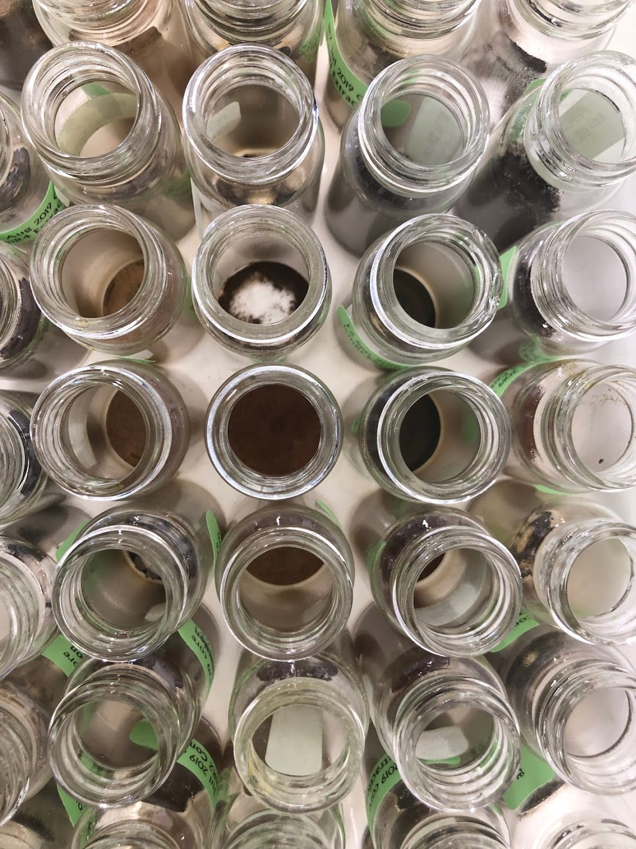
Sediment cores and chemical extractions used to assess effects of oxygenation

Slide 10
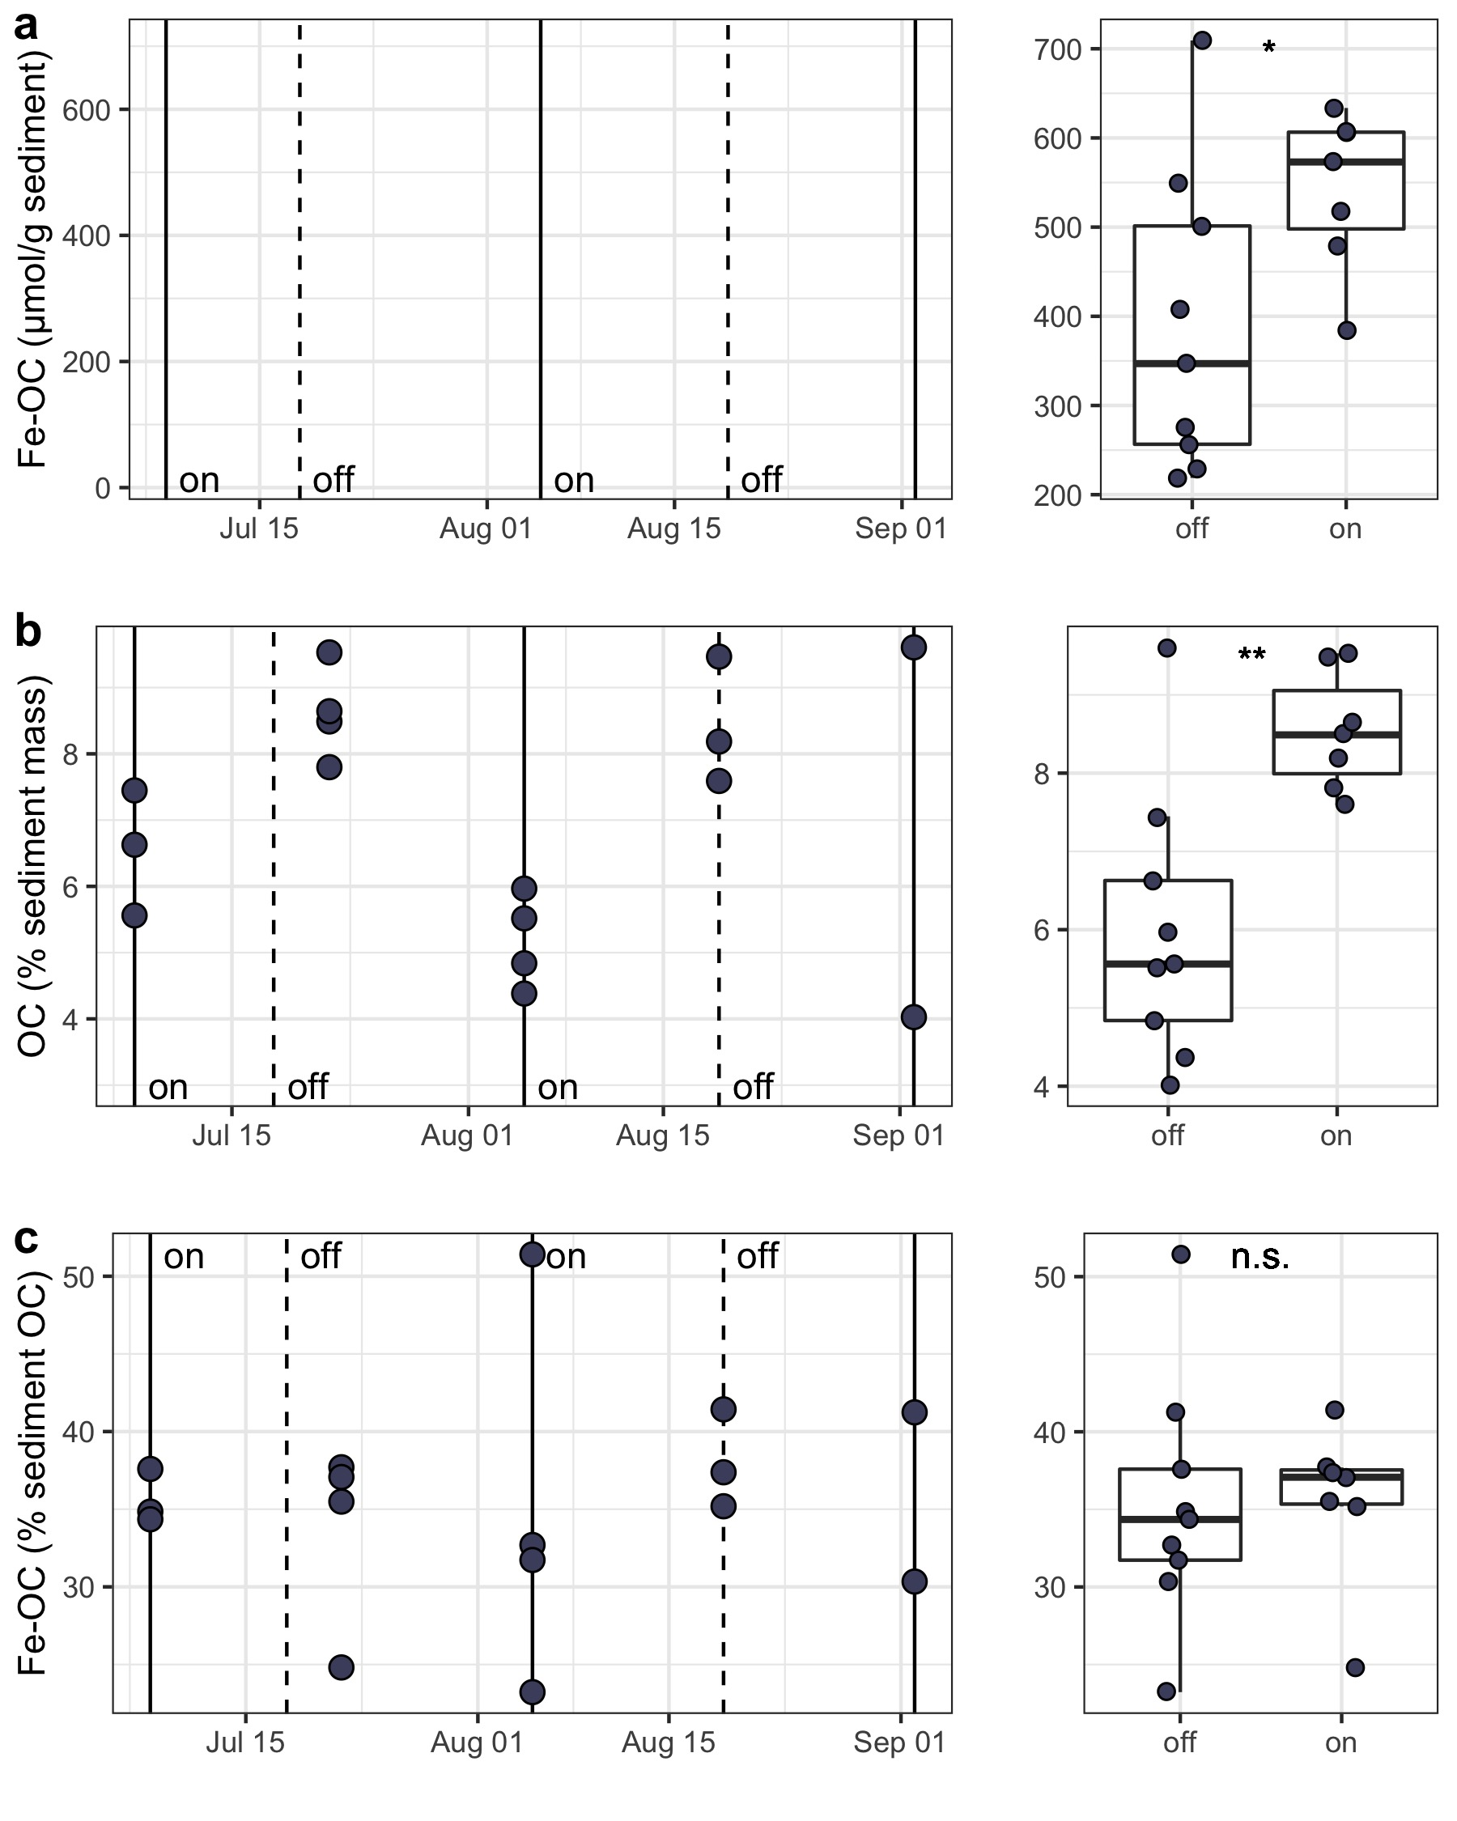
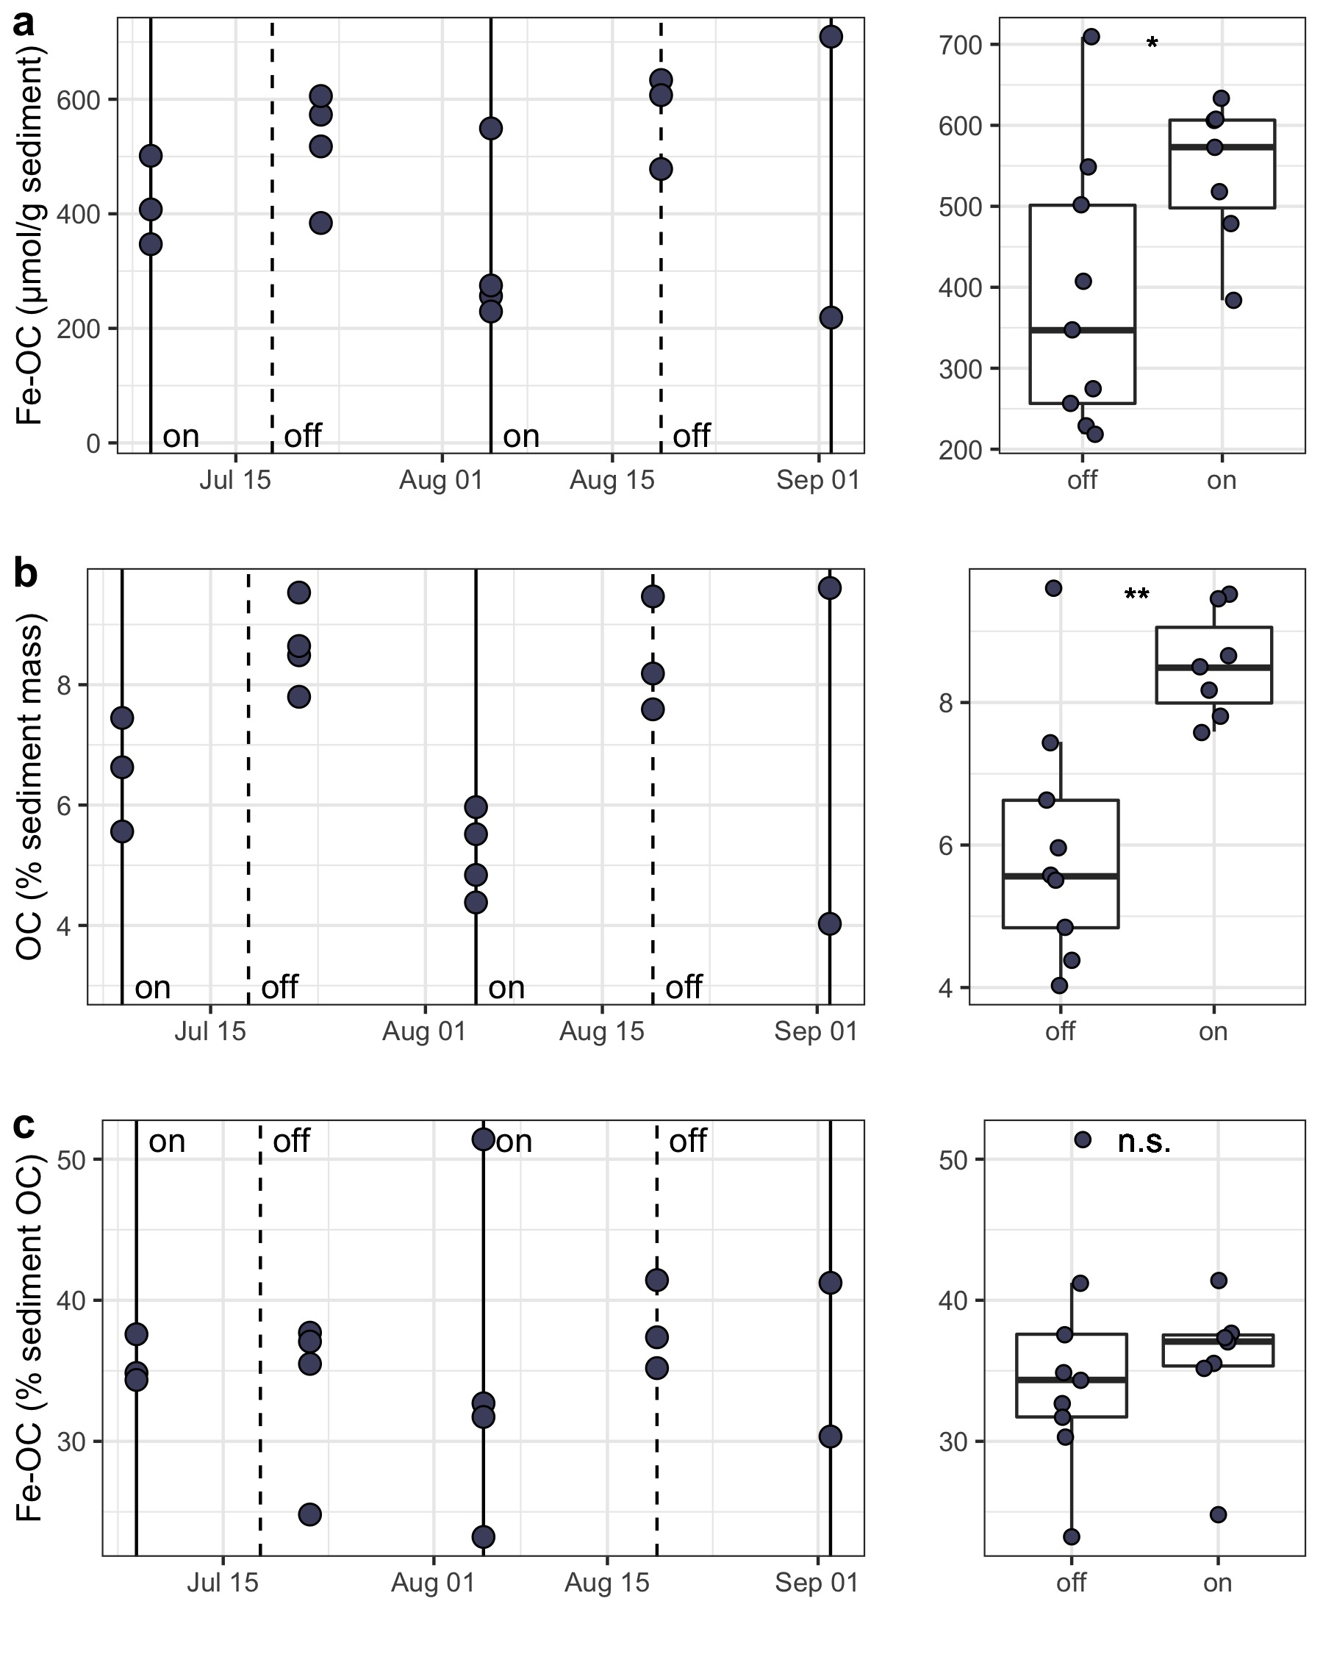
Over short timescales, low-oxygen conditions decrease carbon burial
Iron-bound organic carbon
(µmol/g sediment)
High oxygen
Low oxygen
Organic carbon
(% sediment mass)

Slide 11

Over short timescales, low-oxygen conditions decrease carbon burial
Iron-bound organic carbon
(µmol/g sediment)
Respiration
Mineral protection
Organic carbon
(% sediment mass)
Notes:
Take out scales?

Slide 12
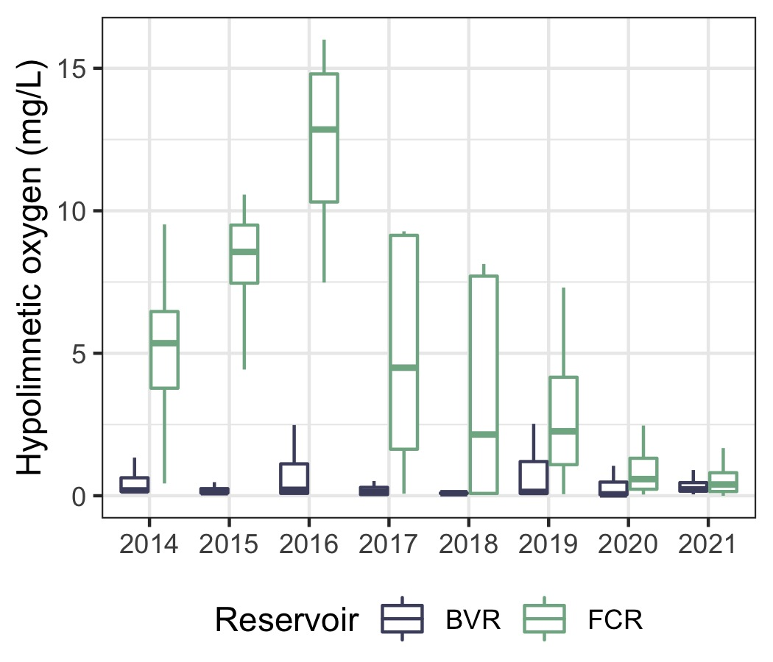
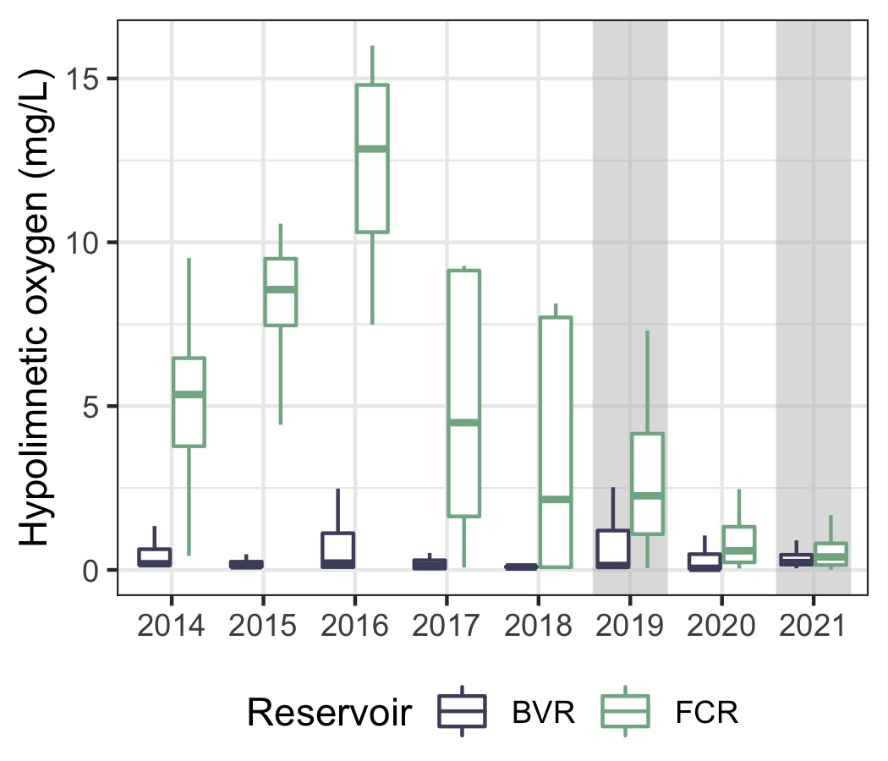
Multiannual oxygenation history provides a basis for understanding long-term effects of hypoxia
Bottom-water oxygen (mg/L)

Slide 13
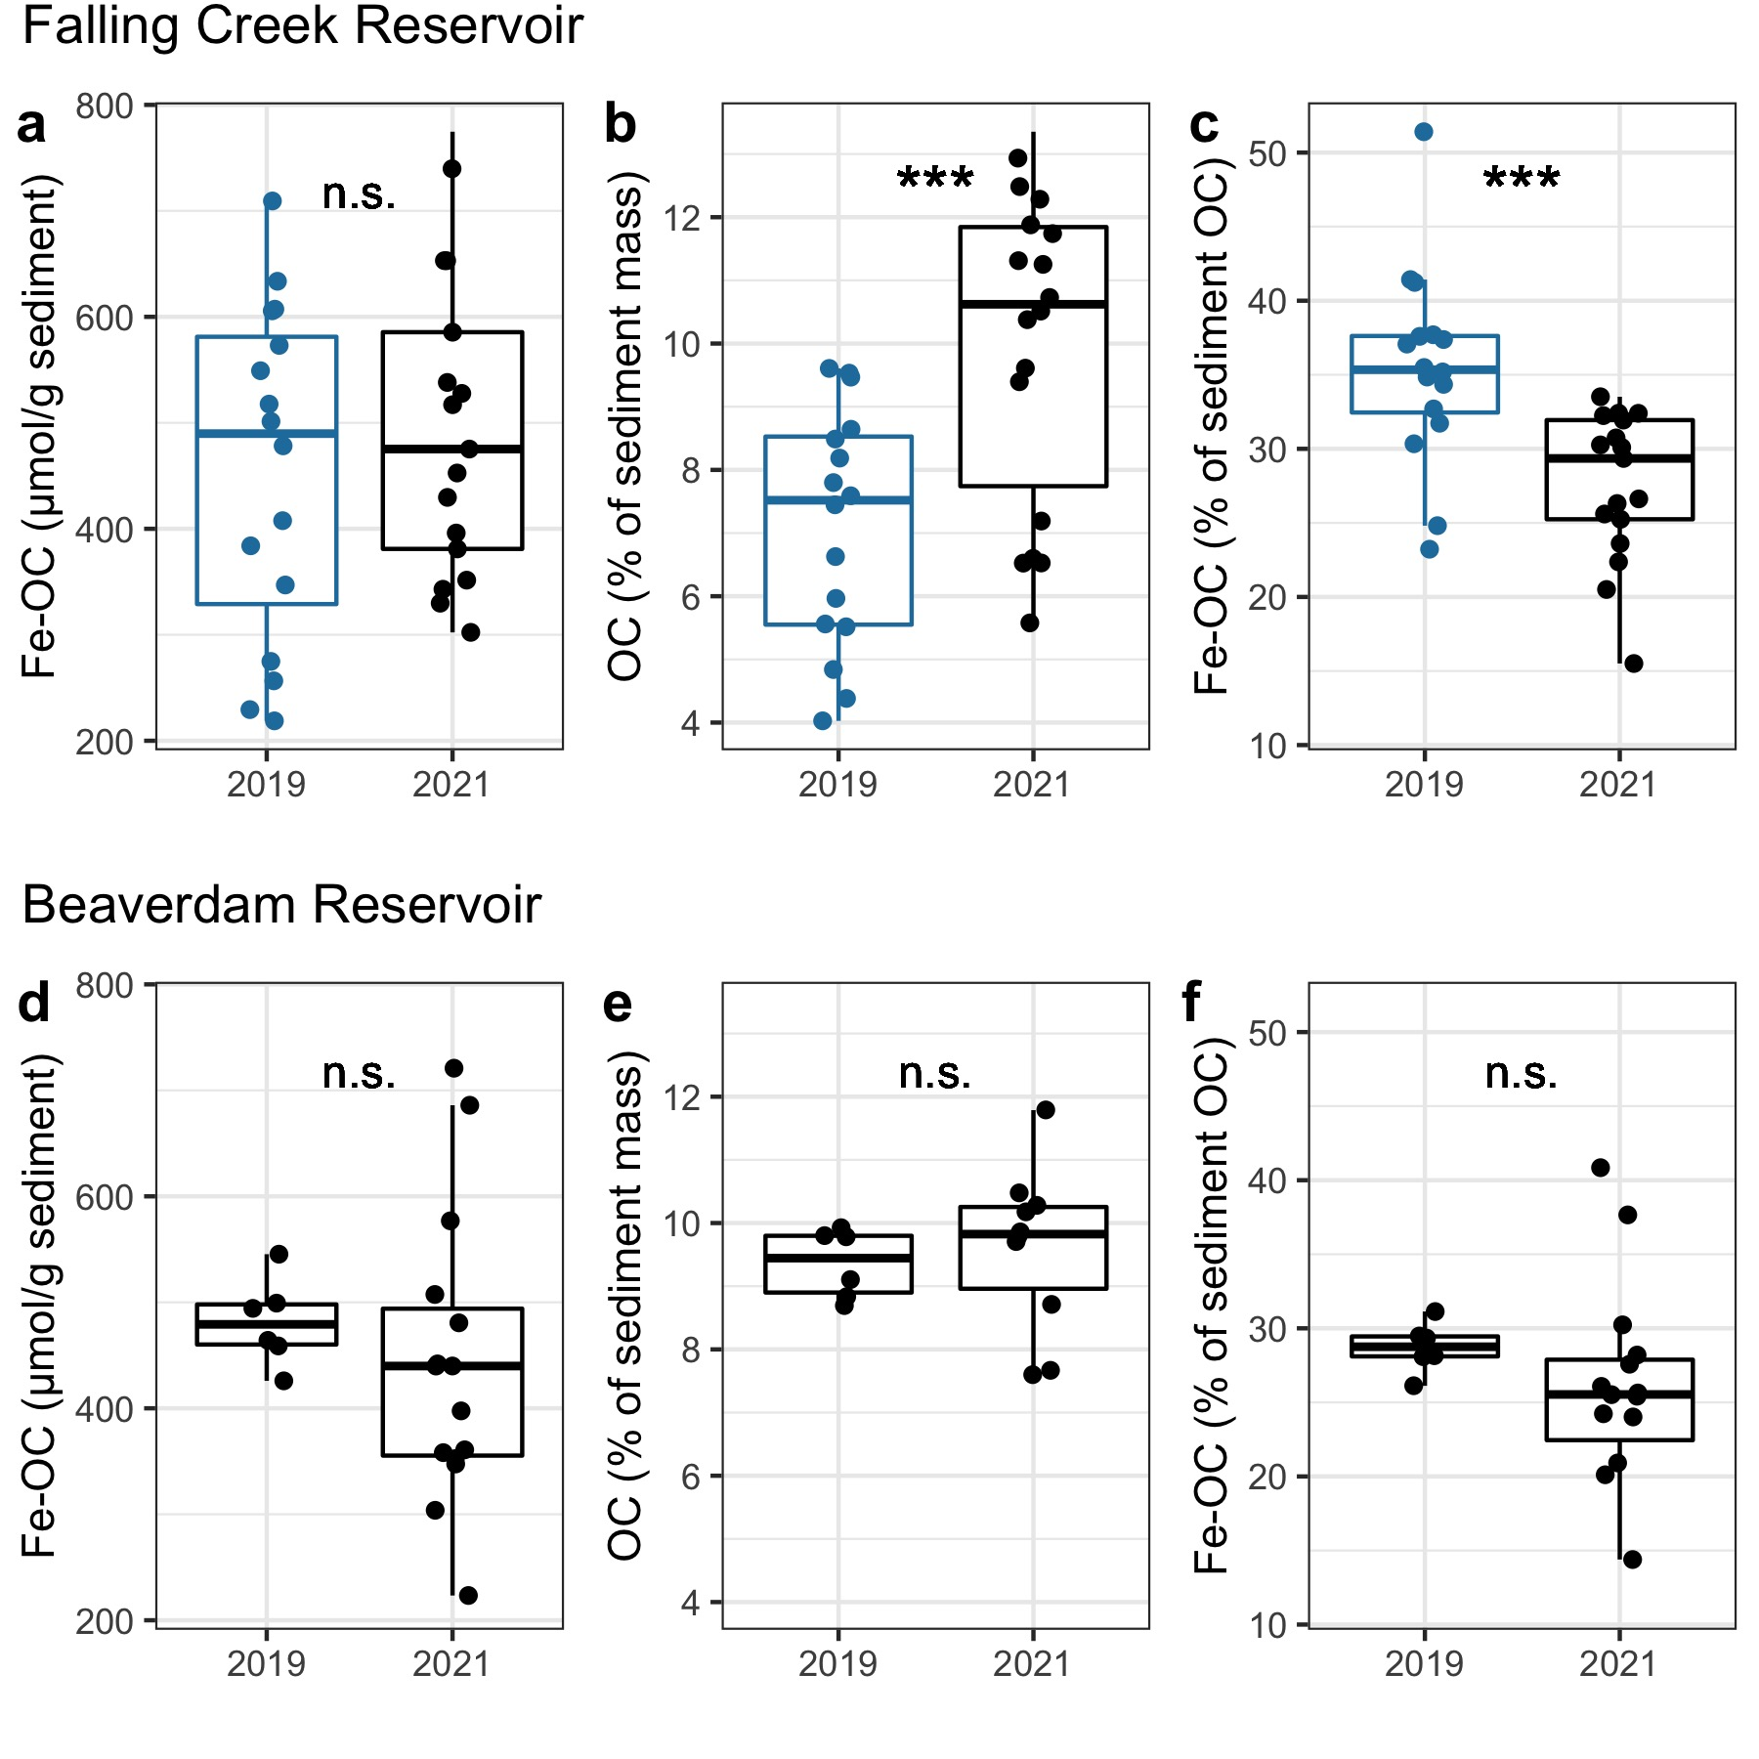
Over multiannual timescales, low-oxygen conditions increase carbon burial
Iron-bound organic carbon
(µmol/g sediment)
Organic carbon
(% sediment mass)
Iron-bound organic carbon
(µmol/g sediment)
Organic carbon
(% sediment mass)
(high-oxygen)
(low oxygen)
Mineral protection
Respiration

Slide 14
Conclusions
Increasing anoxic duration may dramatically alter carbon cycling processes in lakes and reservoirs
Anoxia increases carbon burial over multiannual timescales, likely decreasing carbon export and emission from freshwater reservoirs
Short-term (2-week)
Long-term (multiannual)
Respiration
Mineral protection
Mineral protection
Respiration
Notes:
Link image to carbon burial

Slide 15
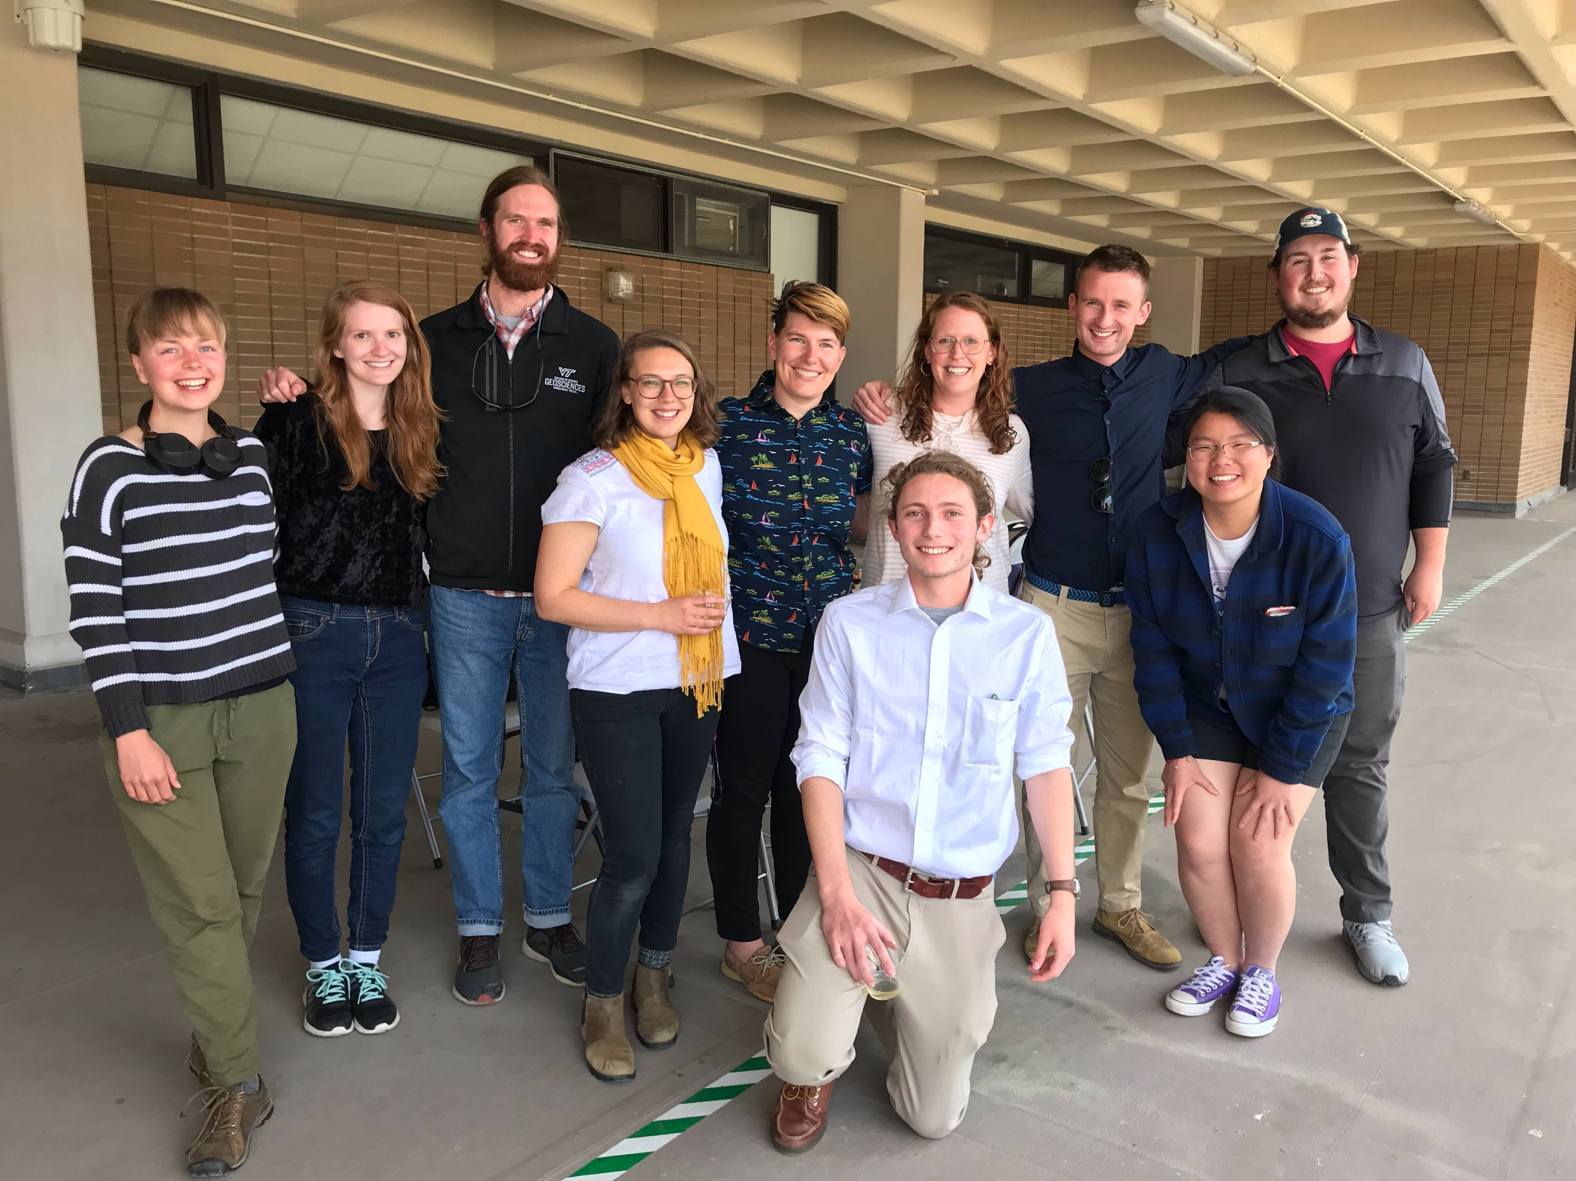


aslewis@vt.edu
@lewis_lakes
Notes:
I want to thank the Virginia Tech reservoir group for helping collect these data and the western Virginia water authority for allowing us to do work in their beautiful reservoirs. Thanks everyone for listening, and I’m happy to take any questions!

